Slide 1

Computer Engineering (BMR 1123) Basic Computer Programming (BEE 1223) (DEE 4113)
By: Ms. Nur Ruzanna Bt Mohd Rafidi
Email: ruzanna@lincoln.edu.my
Tel: 0142568073

Slide 2
Lecture 1 C Programming Fundamentals

Slide 3
What is a program?
A list of instructions
Written in a programming language (c, c++,java)
Determines the behavior of a machine (computer,robot)

Slide 4
Programming Language?
A machine language that has its own set of grammatical rules
It is used to instruct a machine to perform specific tasks.

Slide 5
Development stages of C program?
Editing
Pre-processing and compiling
Linking
Executing

Slide 6
Editing
Process of writing the C source code.
Using editor program (i.e. vi and emacs for Linux, Notepad for windows).
Software package provides programming environment
- Integrated editor.
- Managing and maintaining source code.
-i.e. C++ Builder, Code:: Blocks, Dev-C++, Microsoft Visual Studio.

Slide 7
Pre-processing and Compiling
Pre-processing-performs directives such as inclusion of header files and substitution.
Compiling- process of translating the source code (programming language) to machine code (machine language).

Slide 8
Linking
Process of combining generated object files.
Add required codes from C standard library.
Produce an executable file.

Slide 9
Executing
Run the program to check whether it produce the desired output.
Testing stage where you check the output of your program.
Test program does not produce the suppose output, then you have made logic (semantic) error.

Slide 10
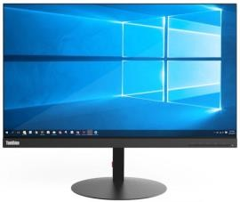

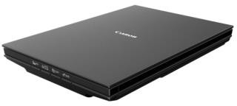
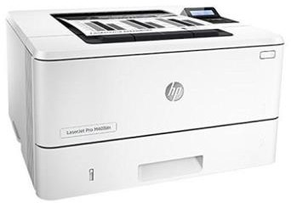
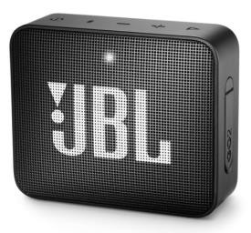
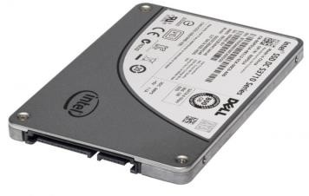
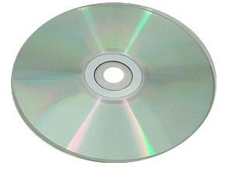

Computer Organization & Hardware
CPU
Control Unit
Arithmetic and Logic Unit (ALU)
Register
Input Device
Output Device
Main Memory
Secondary Memory

Slide 11
Input / Output Units
Input unit – receive information from input devices and place it at the disposal of the other units for processing
e.g. input device : keyboard, mouse, touch screen, scanner
Output unit – takes information the computer has processed and places it on output devices to make it available for use outside the computer
e.g. output device : monitor, printer, speaker

Slide 12
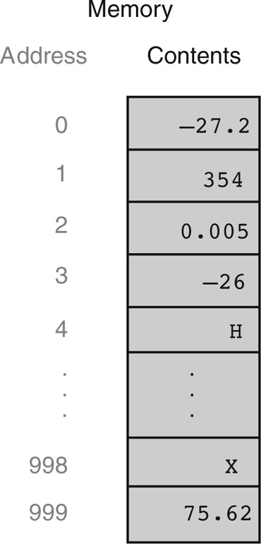
Memory Units
Retain information has been entered through input unit, making immediate available for processing when needed
Also retain process information until it can be placed on output devices
Classified into:
Random Access Memory (RAM)
information in RAM lost when the computer is off
Read Only Memory (ROM)
has been set during manufacturing process, contain instruction and information considered to be fundamental to the computer

Slide 13
Arithmetic & Logic Unit (ALU)
Perform calculation
addition
subtraction
multiplication
division
Contain decision mechanism (comparison)

Slide 14
Central Processing Unit (CPU)
CPU is computer administrative section responsible to coordinates and supervises the operation of the other sections.
Operation CPU to coordinates:
Input unit when information should be read into the memory unit
ALU when information from the memory unit should be used in calculation
Output unit when to send information from the memory unit to
certain output devices

Slide 15
Secondary Storage Unit
Program or data not actively being used by the other units normally placed on secondary storage device
Information on storage device is persistent and preserved even when computer power is off
Secondary storage device – hard disk, CD, USB flash drive

Slide 16
Software
As a complement to hardware, computer system need software to solve problems
Software are classified into:
System software : Manages the computer and its peripheral devices (hardware)
e.g. Operating system (OS), text editor, pre-processor, language translator, linker, loader
Application software : perform specific tasks
2 types of task:
program solve specific problems
program written by user to solve specific problem
e.g. processor, desktop publishing software, spreadsheets, database, graphics, communication, programs perform specific tasks such as accounting, scientific, engineering, education.

Slide 17


Program Languages
Divided into 3 categories:
 Machine language
Language understood by the computer
Bunch of 0’s & 1’s
Hard to learn by human
Machine dependent and not portable
Program is too long to solve simple problem
Assembly language
String of 0’s and 1’s replace into instruction which resemble English language to represent computer operation
Easier to understand and write
Need language translator (Assembler) to change to machine code
Still too long and not portable

Slide 18
Program Languages (Cont…)
High-Level language
Improves weaknesses in machine language and assembly language
Portable
Written in one instruction to carry out several instructions in machine
level
Needs Compiler : a system software that translates source program to
object program
C is one of most widely used high-level programming languages

Slide 19
Algorithms
An algorithm is a sequence of a finite number of steps arranged in a specific logical order that, when executed, produces the solution for a problem.
An algorithm design should be put on paper. For this purpose, and also to facilitate its development, we resort to pseudocoding and flowcharting

Slide 20
Algorithms
The solution to any computing problem involve executing series of actions in specific order
Pseudocode – artificial and informal language that helps develop algorithms
if student grade greater than 50
print ‘Pass’
else
print ‘Fail’

Slide 21

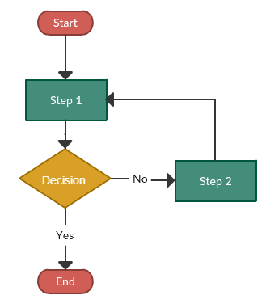


Algorithms (Cont…)
Flowchart – visual-form of an algorithm
Start / End
Input / Output
Flow direction
Process
Decision

Slide 22
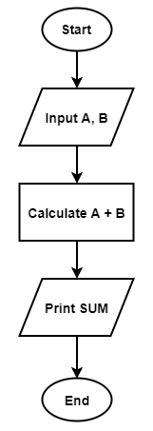
Algorithms (Cont…)
Write a pseudo code, flowchart and program that calculates and prints the SUM of two integers A and B.
Start
Input variable A and B Calculate A add B Print result of SUM
End

Slide 23
Pseudocoding
Semiformal, English-like language with a limited vocabulary that can be used to design and describe algorithms.
Example: Problem A - Compute total of two numbers
Begin
read num1
read num1
total = num1 + num2
print ‘total’
End
Sequence Structure

Slide 24
Example Flowchart
Begin
Read num1, num2
total = num1 + num2
Flowchart for Problem A
(Sequence Structure)
Print ‘total’
End

Slide 25
Pseudocode & Flowchart Convention
Sequence Structure
a series of steps or statements that are executed in order (eg : pg1,AddNote)
begin
Statement_1
Statement_2
…
Statement_n
end
Statement 1
Statement 2
Statement..n

Slide 26
Introduction to C Languange
C is developed by Dennis Ritchie
C is a structured programming language
C supports functions that enables easy maintainability of code, by breaking large file into smaller modules
Comments in C provides easy readability
C is a powerful language

Slide 27
Program Structure
A sample C Program
#include<stdio.h>
Int main()
{
--other statements
//Comments after double slash
}

Slide 28
Header Files
The files that are specifies in the include section is called as header file
These are precompiled files that has some functions defined in them
We can call those functions in our program by supplying parameters
Header file is given an extension .h
C course file is given an extension .c

Slide 29
Preprocessor Directives
An instruction to pre-processor before compiling
Standard library header: stdio.h, math.h, stdlib.h, string.h
❑
Perform input and output operation
❑
Conversion number-text vise-versa, memory allocation, random number
❑
string processing
#include<stdio.h>
#include<stdlib.h>
#include<string.h>

Slide 30
Main Function
This is the entry point of a program
When a file is executed, the start point is the main function
From main function the flow goes as per the programmer's choice.
There may or may not be other functions written by user in a program
Main function is compulsory for any c program

Slide 31
Comments in C
Single line comment
// (double slash)
- Termination of comment is by pressing enter key
Multi line comment
/*….
…….*/
This can span over multiple lines

Slide 32


Comments in C
Start with “ /* ” and terminates with “ */ ”
Or character “ // ” starts a line comments, if several lines, each
line must be begin with “ // ”
Comment cannot be nested “ /* /**/ */ ”

Slide 33
Data Types in C
Primitive data types
-int, float, double, char
Aggregate data types
Arrays come under this category
Arrays can contain collection of int or float or char or double data

Slide 34
Data Types & Memory Allocation
Determine by following:
Type of data stored
Number of bytes it occupies in memory
Range of data
Operation that can be performed on the data
Data Types | Description | Size (bytes)
char | A single character. Internally stored as a coded integer value (refer to ASCII table). | 1
int | Integer quantity. Represented in signed or unsigned form (with the unsigned keyword). | 4
float | Floating-point number. Set of real numbers. | 4
double | A more precise version of float. Has larger dynamic range and better representation of decimal points. | 8
bool | Boolean representation of logic states. Can only be assigned true (1) or false (0). | 1

Slide 35
Data Types & Memory Allocation (Cont…)
Type | Bits | Bytes | Range
char or signed char | 8 | 1 | -128 to +127
unsigned char | 8 | 1 | 0 to +255
int or signed int | 32 | 4 | -2,147,483,648 to +2,147,483,647
unsigned int | 32 | 4 | 0 to +4,294,967,295
short int or signed short int | 16 | 2 | -32,768 to + +32,767
unsigned short int | 16 | 2 | 0 to +65,535
long int or signed long int | 32 | 4 | -2,147,483,648 to +2,147,483,647
unsigned long int | 32 | 4 | 0 to +4,294,967,295
float | 32 | 4 | 3.4 e-38 to 3.4 e+38
double | 64 | 8 | 1.7e-308 to 1.7e+308
long double | 64 | 8 | 1.7e-308 to 1.7e+308

Slide 36
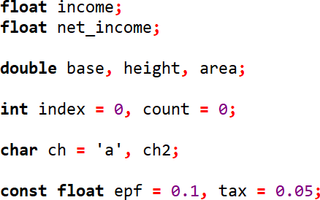
Data Types Declaration
float income, net_income
declare and initialize

Slide 37
Types of Operators
Types of operators are:
Arithmetic operators (+, -, *, /, %)
used to execute mathematical equations
result usually assigned to variable using assignment operator ( = )
C Operation | Arithmetic Operator | Algebraic Expression | C Expression
Addition | + | f + 7 | f + 7
Subtraction | - | p - c | p - c
Multiplication | * | bm | b * m
Division | / | x / y | x / y
Remainder (Modulus) | % | r mod s | r % s

Slide 38
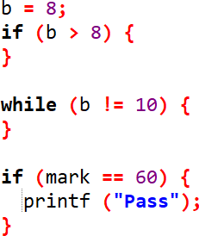
Types of Operators (Cont…)
Relational operators (>, <, ==, >=, <=, !=)
- use mathematical comparison on two data but give logical output
- do not confuse “ == ” (relational operator) with “ = ” (assignment
operator)

Slide 39
Types of Operators (Cont…)
Relational operators (>, <, ==, >=, <=, !=)
Relational Operator | C Operator | Example | Meaning
> | > | x > y | x greater than y
< | < | x < y | x less than y
≥ | >= | x >= y | x greater than or equal y
≤ | <= | x <= y | x less than or equal y
= | == | x == y | x is equal y
≠ | != | x != y | x is not equal y

Slide 40
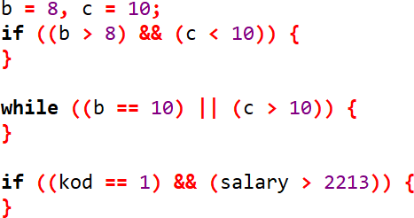
Types of Operators (Cont…)
Logical operators (&&, ||)
- are manipulation of logic
A | B | A && B (Logical AND) | A || B (Logical OR)
false | false | false | false
false | true | false | true
true | false | false | true
true | true | true | true

Slide 41

Types of Operators (Cont…)
Compound assignment operators (+=, -=, *=, /=, %=)
to calculate value from expression and store it in variable
combines binary operator with assignment operator
equivalent to

Slide 42
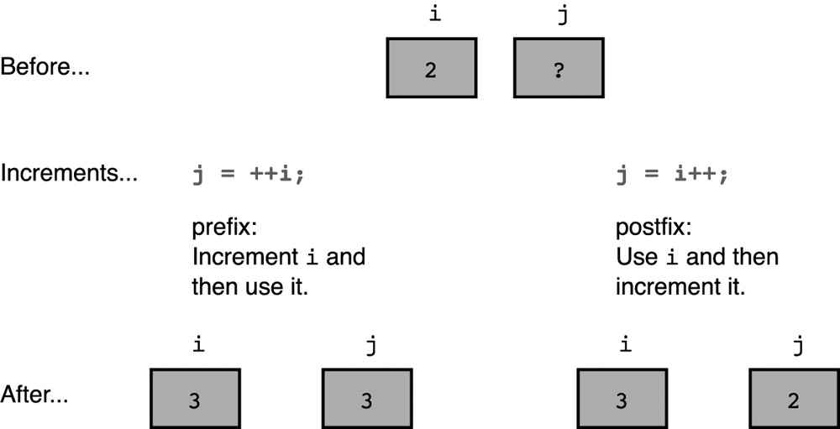
Types of Operators (Cont…)
Unary operators (++, --, -, !, &)
a single operand in an expression or statement
commonly used unary operators is increment/decrement (++, --), arithmetic negation (-), logical negation (!)
Increment/decrement can be both a prefix (value change before
used) and postfix (value change after used) in expression

Slide 43
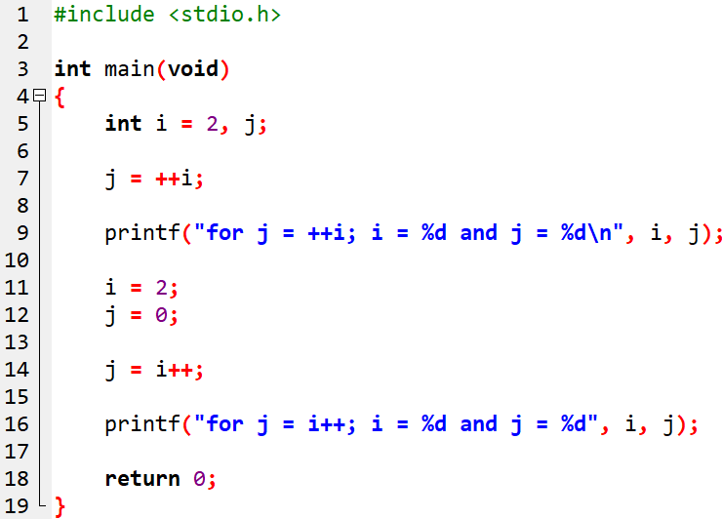
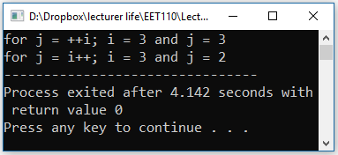
Types of Operators (Cont…)
c1_6.c

Slide 44
Variables
Variables are data that will keep on changing
Declaration
<<Data type>> <<variable name>>;
Int a;
Definition
<<varname>>=<<value>>;
a=10;
Usage
<<varname>>
a=a+1; //increments the value of a by 1

Slide 45
Variable names - Rules
Should not be a reserved word like int
Should start with a letter or an underscore(_)
Can contain letters, numbers or underscore.
No other special characters are allowed including space
Variable names are case sensitive
-A and a are different

Slide 46
Declare Variables
Syntax to declare the variables in C programming is
int age;
Here, age is a variable to create this variable, we have used the int keyword
The age variable can only store integer values. We know this because we have used the data type int to declare it.

Slide 47
Input and Output
Input
-scanf(“%d”,&a);
-Gets an integer value from the user and stores it under the name “a”
Output
-printf(“%d,a);
-Prints the value present in variables a on the screen

Slide 48
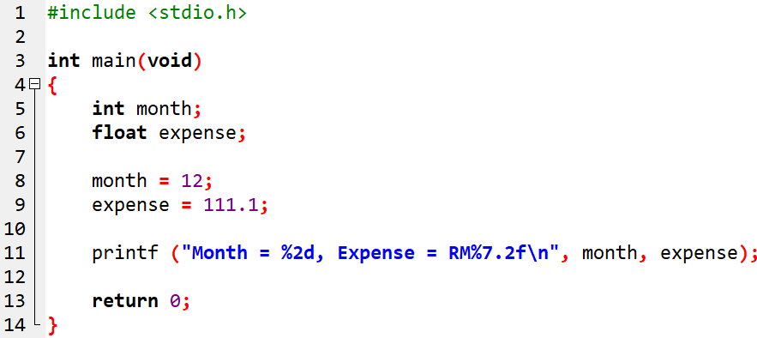
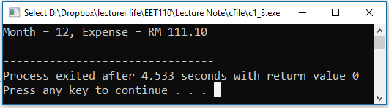
printf
declare variable month to be integer
declare variable expense to be float Assigned value into variable
Correspondence between format control string and variable
c1_3.c

Slide 49
printf (Cont…)
plain character will display unchanged
On display, conversion specification %5d will be replace by value of argument month
On display, conversion specification %7.2f
will be replace by value of argument expense
On display:
Month =
 |  |  | 1 | 2
, Expense = RM
 | 1 | 1 | 1 | . | 1 | 0

Slide 50
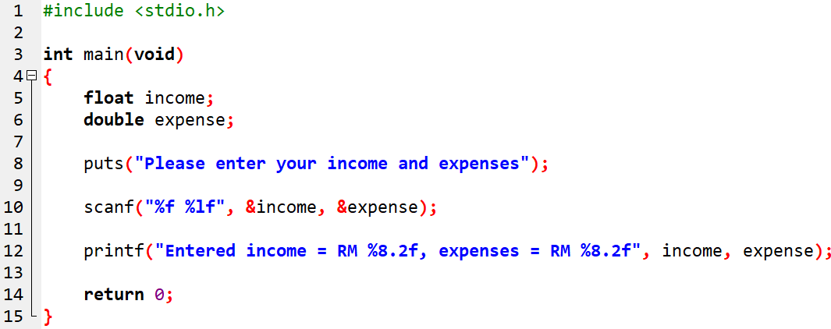
scanf
scanf read value typed on keyboard
c1_4.c

Slide 51
scanf (Cont…)
Type value input income and then saved in a float of variable income
Type value input expense and then saved in a double of variable expense

Slide 52
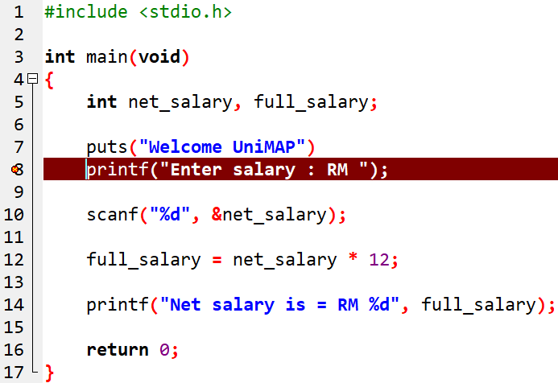

Program Debugging
Syntax error
Mistake cause by violating “grammar” of C
C compiler can easily diagnose during compilation
c1_5.c

Slide 53
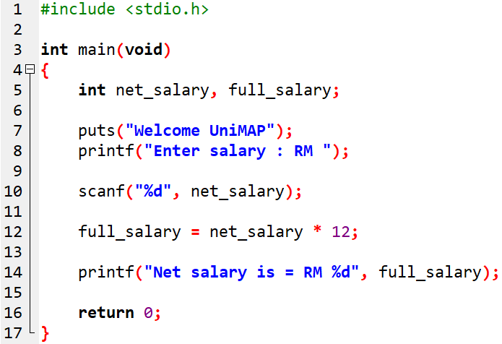
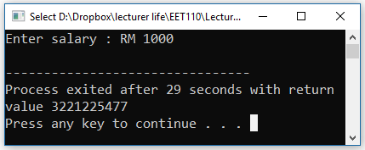
Program Debugging (Cont…)
Run-time error
Called semantic error or smart error
Violation of rules during program execution
C compiler cannot recognize during compilation
c1_5.c

Slide 54
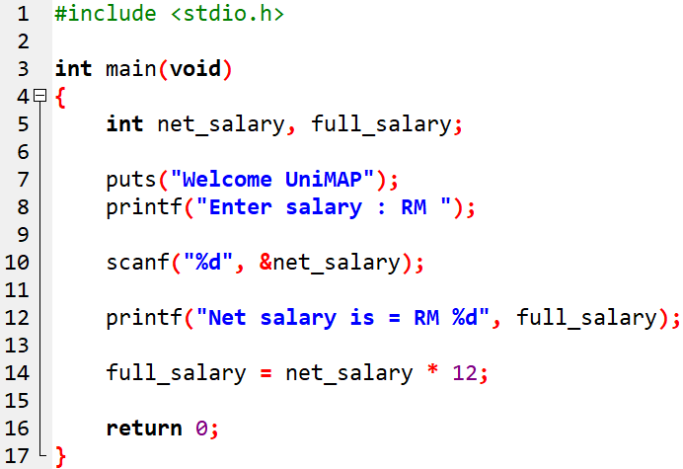
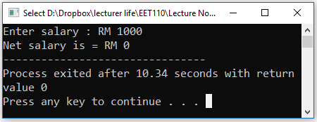
Program Debugging (Cont…)
Logic error
Most difficult error to recognize and correct
Program compiled and executed successfully but answer wrong
c1_5.c

